Slide 1
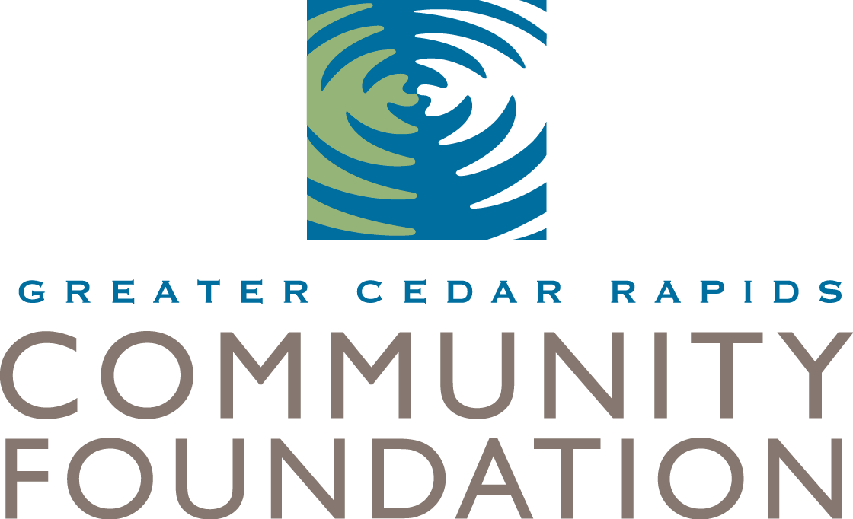
Incorporating endowment building and planned giving strategies

Slide 2
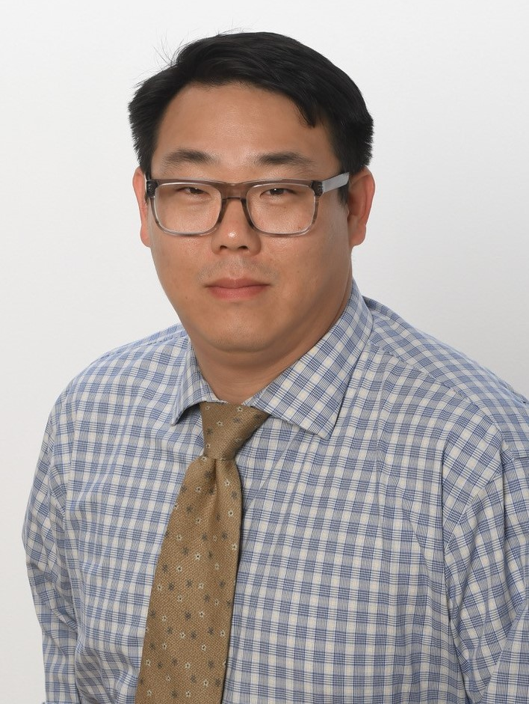
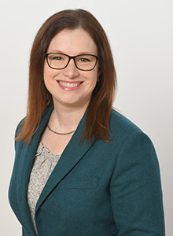
Your Presenters
Arthur Kim, CAP®
Development Officer
Laura Booth, CFRE
Director of Family Philanthropy

Slide 3
ROLES OF Community Foundations
Connect donors to important causes
Create legacies
Make high-impact grants
Provide donors access to the Endow Iowa tax credit program
Build community
Support for Nonprofit Organizations
Leadership on important issues

Slide 4
Endowment Basics

Slide 5
WHAT IS AN Endowment?
An endowed fund is a permanent fund that is established by a donor to help ensure the long-term sustainability of nonprofit organizations by providing a permanent source of support.
At community foundations endowed funds are pooled and invested to achieve long-term growth by balancing principal protection with distributions. Contributions to endowed funds at qualified community foundations may be eligible for Endow Iowa tax credits.

Slide 7
Power of the endowment
Assume an endowment fund earns a net total return averaging 6-7% annually and has a payout policy allowing a 4.5% distribution.
 | Years
 | 1 | 2 | 3 | 4 | 5 | 6 | 7 | 8 | 9 | 10 |  | Summary
Beginning Balance | - | 10,550 | 10,668 | 10,786 | 10,900 | 11,014 | 11,129 | 11,245 | 11,363 | 11,482 |  | -
Contribution | 10,000 | - | - | - | - | - | - | - | - | - |  | 10,000
Grants | - | (462) | (468) | (480) | (485) | (490) | (496) | (501) | (506) | (511) |  | (4,400)
Investment Gains | 700 | 739 | 747 | 755 | 763 | 771 | 779 | 787 | 795 | 804 |  | 7,640
Fee | (150) | (158) | (160) | (162) | (163) | (165) | (167) | (169) | (170) | (172) |  | (1,637)
Ending Balance | 10,550 | 10,668 | 10,786 | 10,900 | 11,014 | 11,129 | 11,245 | 11,363 | 11,482 | 11,602 |  | 11,602

Slide 8
Endow your annual gift
What if the endowment fund had been established 100 years ago?
The fund would:
Distribute $5,187 this year
Have a current value of $118,137
Have distributed $197,647 over the lifetime of the fund
How much impact do your Donors want to have 100 years from now?

Slide 9
Types of endowment giving
Gifts Made Today:
Cash and Cash Equivalents
Memorials and Honors
Securities
Real Estate
Closely Held Securities
Board Directed
Retirement Plan Asset
Legacy and Planned Giving:
Bequest
Beneficiary Designation (Retirement Asset)
Life Insurance and Life Insurance Beneficiary
Charitable Gift Annuity
Charitable Remainder Trust

Slide 10
Gift type: Board Directed
What happens if you receive an unrestricted estate gift?
Through your Gift Acceptance Policy, your board can direct that unrestricted gifts be placed into your endowment fund.
Guidelines for the size and portion to be placed into your endowment fund can be determined in advance and provide parameters for future gifts.
Establishing these guidelines prior to receipt a gift allows your board to be strategic, rather than make a rush decision.

Slide 11
Gift type: Retirement plan assets
QCD: QUALIFIED CHARITABLE DISTRIBUTION
A special rule made permanent by Congress in 2015 allows certain donors to use their IRA assets to make a QCD without incurring income tax on the withdrawal from the IRA. Some limitations include:
Donor must be age 70 ½ or older at the time the gift is made
The transfer must be made from the IRA administrator directly to the charity
The check deposit must clear by December 31
Contributions cannot be made to a Donor-Advised fund, supporting organization or private foundation
Notes:
LB

Slide 12
Gift type: Retirement plan assets
With fewer taxpayers itemizing, donations from retirement accounts are looking better and better.
There are real benefits for older donors who give from their IRA accounts, but too few know about the option.
2025 QCD limit = $108,000
Notes:
LB

Slide 13
endowment prospects
A donor is an endowment prospect if you can answer ‘yes’ to the following points:
Has been in an ongoing relationship with the charity
Has charitable interest
Has money, stocks, property or other assets to give
Has confidence in gift officer and the charity
Has made QCD gifts

Slide 14
ideas to cultivate prospects
Understand the process (ability to give / affinity)
Discover and understand each donor’s personality style, dreams and fears as it relates to the process
Set and achieve clear goals for each scheduled personal visit
Moves management refers to the process by which a prospective donor is moved from cultivation to solicitation. “Moves” are the actions an organization takes to bring in donors, establish relationships, and renew contributions.

Slide 15
Legacy Societies
Provides recognition for estate gift donors
Minimum gift levels
Roster and recognition
Gift values
Annual recognition
Continued stewardship
New current gift or additional estate gift
If revocable, ensure gift stays with your organization

Slide 16
Engaging your board in endowment building
When to consider an endowment initiative:
Clear mission and history of accomplishment
Financial stability
Adequate annual fund and donor base
Committed present and past board leadership
Time

Slide 17
Engaging your board in endowment building
Four Critical Steps:
Engage board in Mission
Engage board in annual and major gifts giving
Build understanding of endowments
Find a champion

Slide 18
professional advisors
Types of Professional Advisors:
Attorneys (Estate Planning/Tax)
Accountants
Trust Officers
Wealth Managers/Financial Advisors
Notes:
LB

Slide 19
Why Professional advisors are important
Gatekeepers
Independent advice to clients
Prompt charitable planning conversation from tax perspective
Potential resource for technical help
Notes:
LB

Slide 20
Ideas to cultivate professional advisors
Invite them to serve on your board or a committee
Include a line on your legacy society form asking donors to identify their professional advisor
Send a thank you note to the attorney/law firm when a bequest gift comes in
Send a targeted newsletter
Join a membership organization such as:
Eastern Iowa Planned Giving Council
Cedar Rapids Estate Planning Council
Notes:
LB

Slide 21
Planned Giving Basics
Notes:
LB

Slide 22
WHAT IS A Planned gift?
The process in which a donor or potential donor creates a financial or estate plan in which they formally decide to give something of value to an organization at a future date.
The definition of planned giving sometimes includes:
Retirement plan gifts during a donor’s lifetime
Major gifts
Notes:
LB

Slide 23
Types of planned gifts
DEFERRED GIFTS
Estate Bequest
Retirement accounts (401k/403b/IRA/Pension)
Life Insurance
GIFTS THAT PAY AN INCOME
Charitable Remainder Trusts
Charitable Gift Annuity
GIFTS THAT PROTECT ASSETS
Charitable Lead Trust
Retained Life Estates
Notes:
LB

Slide 24
Deferred gifts
ESTATE BEQUEST
Named as a beneficiary of donor’s estate in their Will or Trust
Provide EIN to the attorney
Manage the donor intent through a Letter of Intent
Revocable
Sample bequest from a Revocable Trust:
Notes:
LB

Slide 25
Deferred gifts
RETIREMENT ASSETS – 401k, 403b, IRA, Pension
Named as a beneficiary of donor’s retirement account
Can be named as Primary* or Secondary Beneficiary
Manage the donor intent through a Letter of Intent
Revocable
*Spousal consent is required for primary beneficiary designation if the donor resides in a
community property or marital property state: AZ, CA, ID, LA, NV, NM, TX, WA & WI
Notes:
LB

Slide 26
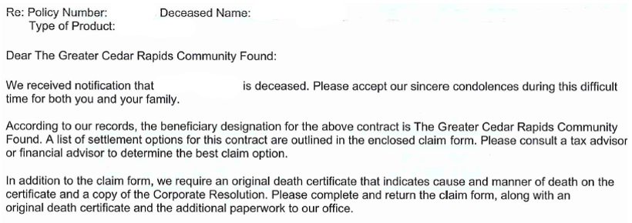
Deferred gifts
LIFE INSURANCE / ANNUITIES
Named as beneficiary in donor’s life insurance policy or annuity
Company typically reaches out when notified of their client’s death
Manage the donor intent through a Letter of Intent
Revocable
Notes:
LB

Slide 27
Planned giving prospects
A donor is a good planned giving prospect if they:
Have been giving to your organization for many years
Have been giving frequently
Have a significant cumulative giving history
Have confidence in the gift officer and organization
Have been a committed volunteer
Contribute via QCD (you KNOW they have an IRA!)
Are single, widowed, divorced, or childless
Notes:
LB

Slide 28
ideas to cultivate planned gifts
Have a familiarity with the terms
Include planned gift wording in your materials, website and donor meetings
ASK - don’t assume they aren’t interested, or that their plans are unchanged
Then, document your conversations thoroughly.
Notes:
LB

Slide 29
RESOURCES
Cedar Rapids Estate Planning Council
crestatecouncil@gmail.com
Community Foundation of Johnson County
www.communityfoundationofjohnsoncounty.org
Eastern Iowa Planned Giving Council
www.eipgc.com
Greater Cedar Rapids Community Foundation
www.gcrcf.org
Notes:
LB

Slide 30
Questions
And
Discussion

